Slide 1
Chapter 2
Descriptive Statistics

Slide 2
Descriptive Statistics
2.1 Describing the Shape of a Distribution
2.2 Describing Central Tendency
2.3 Measures of Variation
2.4 Percentiles, Quartiles, and Box-and-Whiskers Displays
2.5 Describing Qualitative Data
2.6 Using Scatter Plots to Study the Relationship Between Variables
2.7 Misleading Graphs and Charts
2.8 Weighted Means and Grouped Data

Slide 3
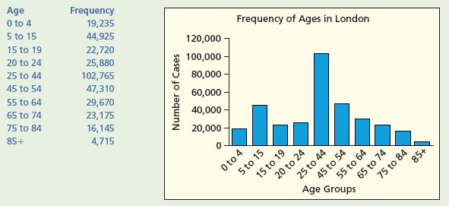
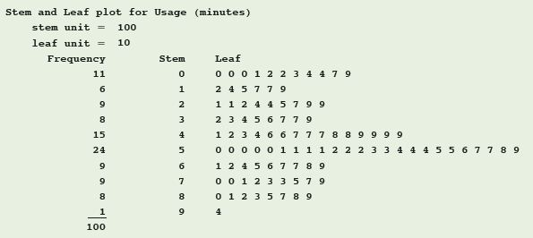
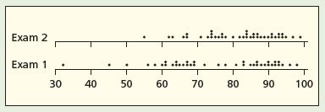
The Shape of a Distribution
To know what the population looks like, find the “shape” of its distribution
Picture the distribution graphically by any of the following methods:
  Stem-and-leaf display
  Frequency distributions
  Histogram
  Dot plot

Slide 4
Stem-and-leaf Display
L01
The purpose of a stem-and-leaf display is to see the overall pattern of the data, by grouping the data into classes
  From this we can see:
    the variation from class to class
    the amount of data in each class
    the distribution of the data within each class
Best for small to moderately sized data distributions

Slide 5
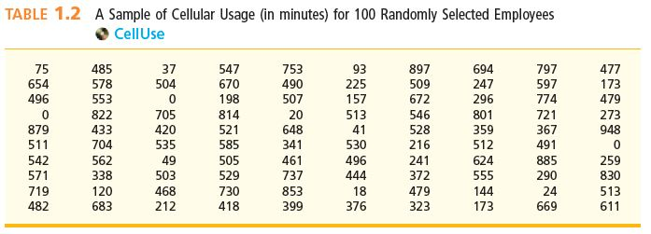
Cellular Telephone Usage
L01
Refer to Example 2.1, Cellular Telephone Usage Case
  Data in Table 1.2
The stem-and-leaf display cellular telephone usage are:

Slide 6
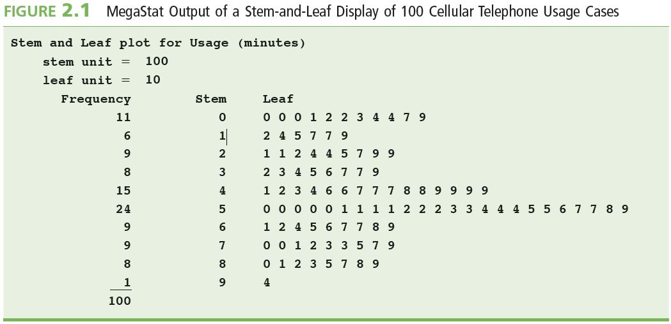
Stem Leaf: Cellular Usage
L01

Slide 7
Cellular Usage: Results
L01
Looking at the last stem-and-leaf display, we can see;
  The first row represents the 11 cases that have times less than 100 minutes
  The majority of the cases are in the 500 to 599 minute range
  The second greatest number of cases is between 400 and 499 minutes
  There are very few (1 in this case) users who have usages of 900 or more minutes

Slide 8
Frequency Distribution
L02
A frequency distribution is a table that groups data into particular intervals called “classes”
  The histogram is a picture of the frequency distribution

Slide 9
Frequency Distribution & Histogram
L02
Steps in making a frequency distribution:
  1. Find the number of classes K
  2. Find the class length
  3. Form classes of equal width (non-overlapping)
  4. Tally and count the number of measurements in each class
  5. Graph the histogram

Slide 10
Number of Classes
L02
Group all of the n data into K number of classes
K is the smallest whole number for which
2^{K} ≥ n
In example 2.2 (The Payment Time case), there are 65 observations in the data set (n=65)
  For K = 6, 2⁶ = 64, < n (less than n=65)
  For K = 7, 2⁷ = 128, > n (greater than n=65)
  So use K = 7 classes

Slide 11
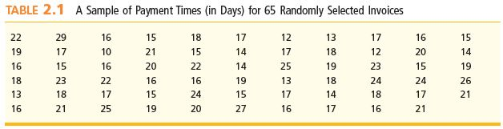
Class Length
L02
Class length L is the step size from one to the next
In Example 2.2, The Payment Time Case,
Arbitrarily round the class length up to 3 days

Slide 12
Starting the Classes
The classes start on the smallest data value
  This is the lower limit of the first class
The upper limit of the first class is
smallest value + L
  In the example, the first class starts at 10 and goes up to 13 (which is 10 + 3), the first class includes 10 but does not include 13
  13 is the upper boundary of the first class and lower boundary of the second class
The second class starts at a lower boundary of 13 and goes to an upper boundary of 16 (16 is the lower boundary of the third class
Continuing in the fashion we get the remaining lower boundaries to be 19, 22, 25, and 28

Slide 13
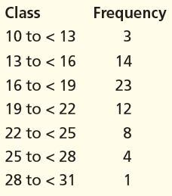
Tallies and Frequencies:
Example 2.2
L02
Examine the 64 payment times, find the frequency of each class by counting the number of recorded for each class.
In the first class “13 to <16”, we count 14 occurrences that will fall in this class
Do this for all classes, the result will look like this;
***Check: All frequencies must sum to n (in this case 65)

Slide 14
Relative Frequency
L02
The relative frequency of a class is the proportion or fraction of data that is contained in that class
  Calculated by dividing the class frequency by the total number of data values
    For example, there are 14 payment times in the second class, so its relative frequency is 14/65 = 0.2154
  Relative frequency may be expressed as either a decimal or percent
  A relative frequency distribution is a list of all the data classes and their associated relative frequencies

Slide 15
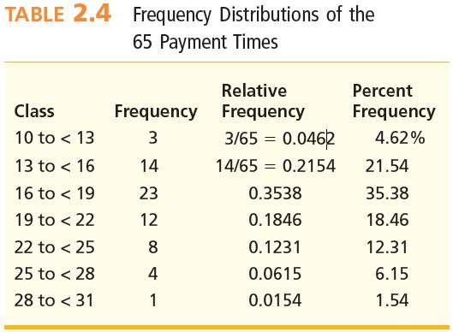
Relative & Percent Frequency
L02
***Check: All relative frequencies must sum to 1 (100%)

Slide 16
Histogram
L02
A graph in which rectangles represent the classes
The base of the rectangle represents the class length
The height of the rectangle represents
  the frequency in a frequency histogram, or
  the relative frequency in a relative frequency histogram

Slide 17
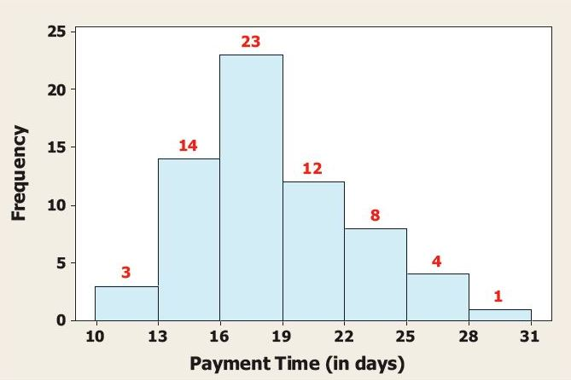
Histograms
L02
Example 2.2: The Payment Time Case
  Frequency and Percent Frequency Histogram
The tail on the right appears to be longer than the tail on the left

Slide 18
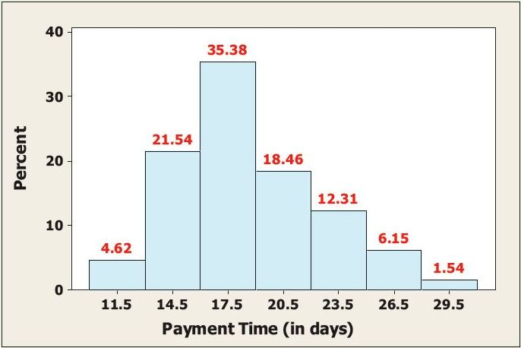
Histograms
L02
Example 2.2: The Payment Time Case
  Percent Frequency Histogram
The tail on the right appears to be longer than the tail on the left

Slide 19
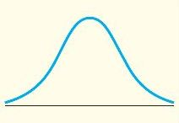
The Normal Curve
L03
Symmetrical and bell-shaped curve for a normally distributed population
The height of the normal curve over any point represents the relative proportion of population measurements that are near the given point

Slide 20
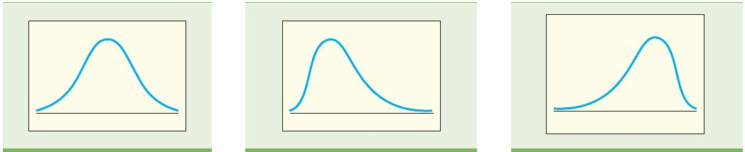
Skewness
L03
Skewed distributions are not symmetrical about their center. Rather, they are lop-sided with a longer tail on one side or the other
  A population is distributed according to its relative frequency curve
  The skew is the side with the longer tail
    A left skew indicates there are a few data that are somewhat lower than the rest
    A right skew indicates there are a few data that are somewhat higher than the rest
Right Skewed
Symmetric
Left Skewed
The height of the relative frequency curve over any point represents the relative proportion of values near that point

Slide 21
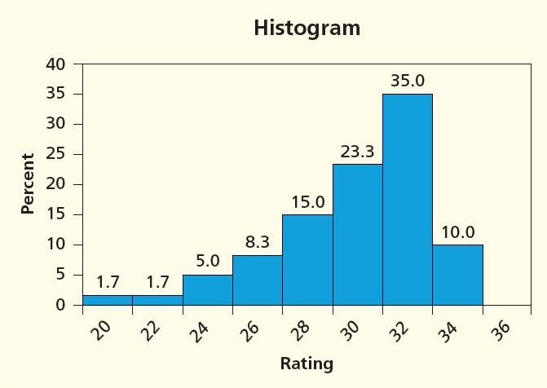
Example 2.4
L03
The Marketing Research Case
  This histogram is normally distributed with a left skew
  The left skew indicates that there are a few ratings that are somewhat lower than the rest

Slide 22

Outliers
L04
Stem-and-leaf displays and dot plots are useful for detecting outliers
Outliers are unusually large or small observations that are well separated from the remaining observations
The way we deal with outliers is dependent on the cause
outlier
On a number line, each data value is represented by a dot placed above the corresponding scale value

Slide 23
Population Parameters
L05
A population parameter is a number calculated from all the population measurements that describes some aspect of the population
The population mean, denoted μ, is a population parameter and is the average of the population measurements

Slide 24
Point Estimates and Sample Statistics
L05
A point estimate is a one-number estimate of the value of a population parameter
A sample statistic is a number calculated using sample measurements that describes some aspect of the sample
  Use sample statistics as point estimates of the population parameters
The sample mean, denoted x, is a sample statistic and is the average of the sample measurements
  The sample mean is a point estimate of the population mean

Slide 25
Measures of Central Tendency
L05
Mean, μ The average or expected value of a population
Median, M_{d} The value of the middle point of the ordered measurements
Mode, M_{o} The most frequent value

Slide 26
The Mean
L05
Population X₁, X₂, …, X_{N}
Sample x₁, x₂, …, x_{n}
μ
Population Mean
Sample Mean
The sample mean is a point estimate
of the population mean μ

Slide 27
The Sample Mean
L05
For a sample of size n, the sample mean is defined as
and is a point estimate of the population mean μ
  It is the value to expect, on average and in the long run

Slide 28
Example
L05
Example: Sample mean for the hourly wages for five vocational areas in business & finance, nature & sciences, health occupations and sales
35.58, 21.16, 31.43, 26.58, 14.54

Slide 29
Mean hourly wage for five vocational areas
L05
Based on this calculated sample mean, the point estimate for the hourly wages for five vocational areas in business & finance, nature & sciences, health occupations and sales is $25.58 per hour

Slide 30
The Median
L05
The population or sample median M_{d} is a value such that 50% of all measurements, after having been arranged in numerical order, lie above (or below) it
The median M_{d} is found as follows:
  If the number of measurements is odd, the median is the middle measurement in the ordering
  2. If the number of measurements is even, the median is the average of the two middle measurements in the ordering

Slide 31
Example: Sample Median
L05
Example 2.6: Personal Expenditures
The average annual amounts people in Canada spent on rent between 1997 and 2005 (covering 9 years)
6,606, 6,806, 7,043, 7,265, 7,523, 7,873, 8,207, 8,533, 8,856
(Note that the values are in ascending numerical order from left to covering right)
Because n = 9 (odd,) then the median is the middle value or 5th value in the list, so
M_{d}=7,523

Slide 32
The Mode
L05
The mode M_{o} of a population or sample of measurements is the measurement that occurs most frequently
  Modes are the values that are observed “most typically”
  Sometimes higher frequencies at two or more values
    If there are two modes, the data is bimodal
    If more than two modes, the data is multimodal
  When data are in classes, the class with the highest frequency is the modal class
    The tallest box in the histogram

Slide 33
DVD Recorder Satisfaction
L05
Satisfaction rankings on a scale of 1 (not satisfied) to 10 (extremely satisfied), arranged in increasing order
1 3 5 5 7 8 8 8 8 8 8 9 9 9 9 9 10 10 10 10
Because n = 20 (even), then the median is the average of two middlemost ratings; these are the 10th and 11th values. Both of these are 8 (circled), so
M_{d} = 8
Because the rating 8 occurs with the highest number of occurrences the mode is
M_{o} = 8

Slide 34
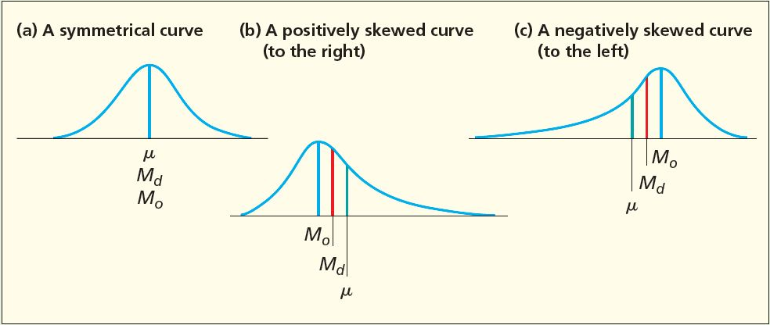
Comparing the mean, median and mode
L05
Bell-shaped distribution:
  Mean = Median = Mode
Right skewed distribution:
  Mean > Median > Mode
Left-skewed distribution:
  Mean < Median < Mode

Slide 35
Median and Mode
L05
The median is not affected by extreme values
  “Extreme values” are values much larger or much smaller than most of the data
  The median is resistant to extreme values
The mean is strongly affected by extreme values
  The mean is sensitive to extreme values

Slide 36
Measures of Variation
L06
Range
Largest minus the smallest measurement
Variance
The average of the squared deviations of all the population measurements from the population mean μ
Standard Deviation
The positive square root of the variance

Slide 37
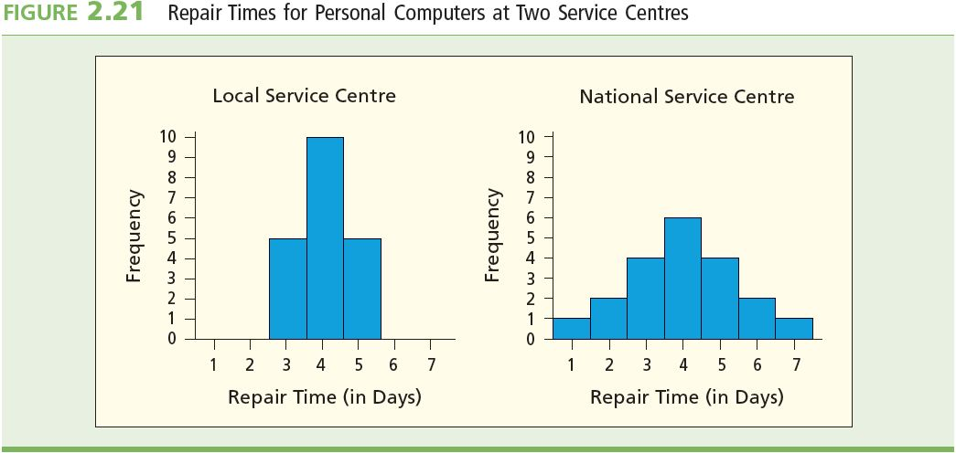
Measures of Variation
L06
It is important to estimate the variation of a population’s individual values
This will allow us to see how two or more distributions differ and hence help make decisions based on that
Populations can have similar means but the variations can be very different

Slide 38
The Range
L06
Range = largest measurement - smallest measurement
The range measures the interval spanned by all the data
In figure 2.21, the smallest and largest repair times for the Local Service Centre are five and three days. For the National Service Centre it is seven days and one day.
The variance of each is 5-3=2 days and 7-1=6 days.
This indicates that the National Service Centre’s repair time exhibit more variation.

Slide 39
The Variance
L06
Population X₁, X₂, …, X_{N}
Sample x₁, x₂, …, x_{n}
s²
σ²
Population Variance
Sample Variance
The sample variance is a point estimate
of the population variance σ²

Slide 40
Variance
L06
For a population of size N, the population variance s² is defined as
For a sample of size n, the sample variance s² is defined as

Slide 41
The Standard Deviation
L06
Population Standard Deviation:
Sample Standard Deviation:

Slide 42
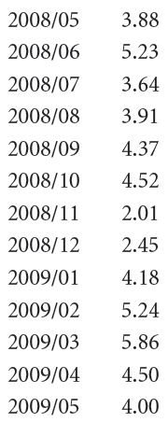
Example 2.9: Sample Variance
L06
Statistics Canada compiles data on manufacturing statistics for Canada.
The monthly numbers of asphalt shingle production (in millions of metric bundles) in Canada from May 2008 to May 2009 is shown

Slide 43
Sample Variance
L06
Computing the mean from this data gives a value of 4.14
The sample variance and standard deviation is

Slide 44
Summary
L06
s² = 1.121 and s = 1.059 are the point estimates of the variance and standard deviation, σ² and σ , respectively, of the entire population
The sample standard deviation, s , is expressed in the same units as the sample values. Therefore, we say that s = 1.059 million metric bundles.

Slide 45
Sample Variance and Standard Deviation
L06
Computational Formula: It can be easier to compute variance and standard deviation using the computational formula as demonstrated using the sample five price points.

Slide 46
Example: Sample Variance and Standard Deviation
L06

Slide 47
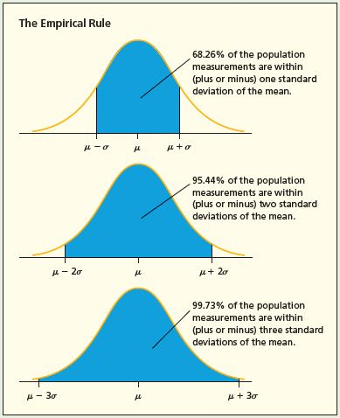
Empirical Rule Normal Populations
If a population has mean m and standard deviation s and is described by a normal curve, then
  68.26% of the population measurements lie within one standard deviation of the mean: [m-s, m+s]
  95.44% of the population measurements lie within two standard deviations of the mean: [m-2s, m+2s]
  99.73% of the population measurements lie within three standard deviations of the mean:
  [m-3s, m+3s]

Slide 48
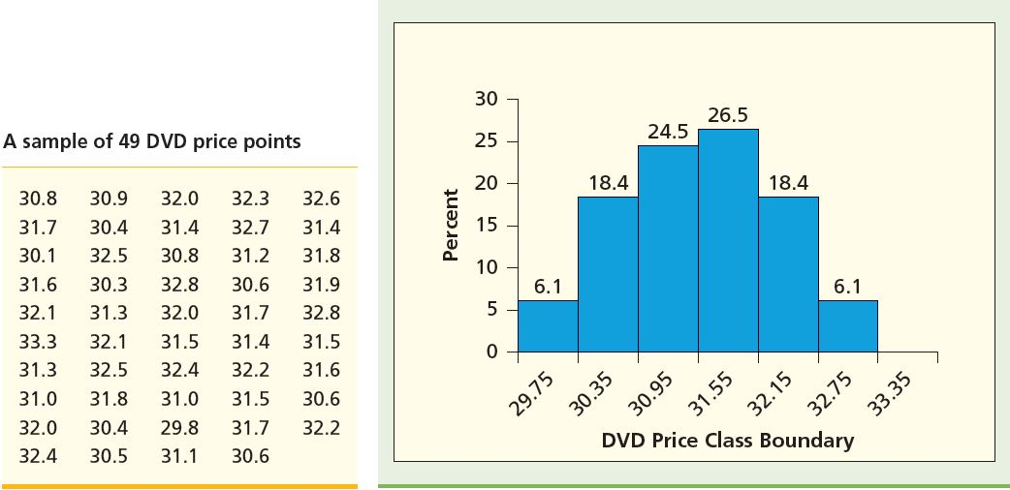
Example: The Empirical Rule
Consider a sample of 49 DVD price points as shown
Computing the mean and standard deviation, we find it to be 31.5131 and 0.8 respectively

Slide 49
Example: The Empirical Rule
Example 2.10: DVD Price Points
If the DVDs have price points that are Normal,
68.26% of all DVDs will have prices in the range
95.44% of all DVDs will have prices in the range
99.73% of all DVDs will have prices in the range

Slide 50
Chebyshev’s Theorem
Let m and s be a population’s mean and standard deviation, then for any value k > 1,
At least 100(1 - 1/k² )% of the population measurements lie in the interval:
[μ−kσ, μ+kσ]
Use only for non-mound-shaped distributions
  Skewed
    But not extremely skewed
  Bimodal

Slide 51
z Scores
For any x in a population or sample, the associated z score is
The z score is the number of standard deviations that x is from the mean
  A positive z score is for x above (greater than) the mean
  A negative z score is for x below (less than) the mean

Slide 52
Example: z score
Population of revenues (billions of dollars) for the five biggest Canadian companies:
$38, 37, 36, 34, 34
m = $35.8 billion, s = 1.60 billion
x | x - mean | z score
38 | 38 - 35.8 = 2.2 | 2.2/1.6 = 1.375
37 | 37 – 35.8 = 1.2 | 1.2/1.6 = 0.75
36 | 36 – 35.8 = 0.2 | 0.2/1.6 = 0.125
34 | 34 – 35.8 = -1.8 | -1.8/1.6 = -1.125
34 | 34 – 35.8 = -1.8 | -1.8/1.6 = -1.125
The first company with revenues of $38B is farthest from
the mean with revenues 1.375 standard deviations from the mean

Slide 53
Coefficient of Variation
Measures the size of the standard deviation relative to the size of the mean
Coefficient of Variation = × 100%
Used to:
  compare the relative variabilities of values about the mean
  Compare the relative variability of populations or samples with different means and different standard deviations
  Measure risk
standard deviation
mean

Slide 54
Percentiles and Quartiles
For a set of measurements arranged in increasing order, the p^{th} percentile is a value such that p percent of the measurements fall at or below the value and (100-p) percent of the measurements fall at or above the value
The first quartile Q₁ is the 25th percentile
The second quartile (or median) M_{d} is the 50th percentile
The third quartile Q₃ is the 75th percentile
The interquartile range IQR is Q₃ - Q₁

Slide 55
Example: Quartiles
20 customer satisfaction ratings:
1 3 5 5 7 8 8 8 8 8 8 9 9 9 9 9 10 10 10 10
M_{d} = (8+8)/2 = 8
Q₁ = (7+8)/2 = 7.5
Q₃ = (9+9)/2 = 9
IQR = Q₃ − Q₁ = 9 − 7.5 = 1.5

Slide 56
Box-and-Whiskers Plots
The box portion of the plot plots the:
  first quartile, Q₁
  median, M_{d}
  third quartile, Q₃
  inner fences, located 1.5×IQR away from the quartiles:
    = Q₁ – (1.5 × IQR)
    = Q₃ + (1.5 × IQR)
  outer fences, located 3×IQR away from the quartiles:
    = Q₁ – (3 × IQR)
    = Q₃ + (3 × IQR)

Slide 57
Box-and-Whiskers Plots Continued
The “whiskers” are dashed lines that plot the range of the data
  A dashed line is drawn from the box below Q₁ down to the smallest measurement that is greater than the lower inner fence
  Another dashed line is drawn from the box above Q₃ up to the largest measurement that is less than the upper inner fence
Note: The smallest value, Q₁, M_{d}, Q₃, and the largest value are sometimes referred to as the five number summary

Slide 58
Outliers
L04
Outliers are measurements that are very different from most of the other measurements
  They are referred to as outliers because they are either very much larger or very much smaller than most of the other measurements
Outliers lie beyond the fences of the box-and-whiskers plot
  Measurements between the inner and outer fences are mild outliers
  Measurements beyond the outer fences are severe outliers

Slide 59
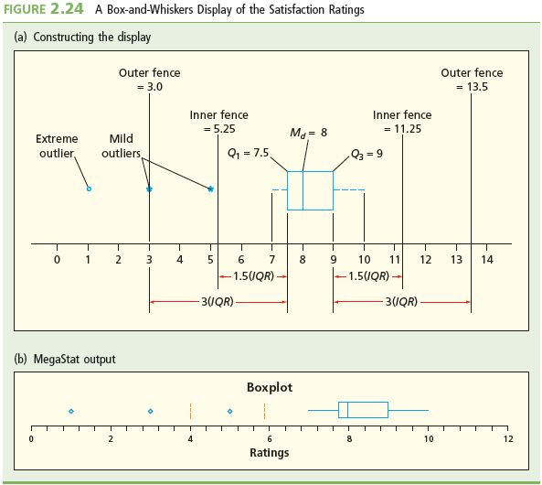
Box-and-Whiskers Plots

Slide 60
Describing Qualitative Data
Bar charts and pie charts are convenient ways to summarize the percentages of population units that are contained in different categories

Slide 61
Population and Sample Proportions
Population X₁, X₂, …, X_{N}
Sample x₁, x₂, …, x_{n}
p
Sample Proportion
Population Proportion
^
p is the point estimate of p

Slide 62
Example: Sample Proportion
Example 2.11: Marketing Ethics Case
117 out of 205 marketing researchers disapproved of action taken in a hypothetical scenario
Make an inference about the population of marketing researchers
X = 117, number of researches who disapprove
n = 205, number of researchers surveyed
Sample Proportion:
This point estimate says we estimate that p, the proportion
of all marketing researchers who disapprove is 0.57

Slide 63
Pareto Chart
Pareto Principle: The “vital few” versus the “trivial many”
Pareto Chart of Labeling Defects

Slide 64
Scatter Plots
Visualize the data to see patterns, especially “trends”
Viscosity vs. Amount of Chemical in a certain bulk product

Slide 65
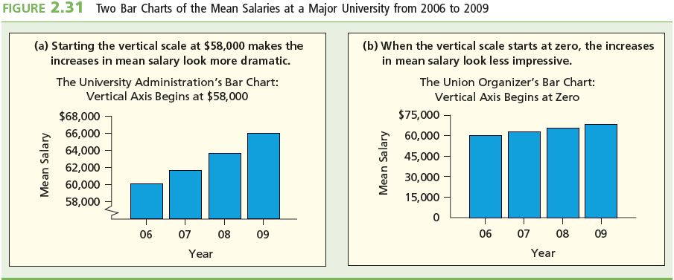
Misleading Graphs and Charts:
Scale Break
Break the vertical scale to exaggerate effect
Mean Salaries at a Major University, 2006 - 2009

Slide 66
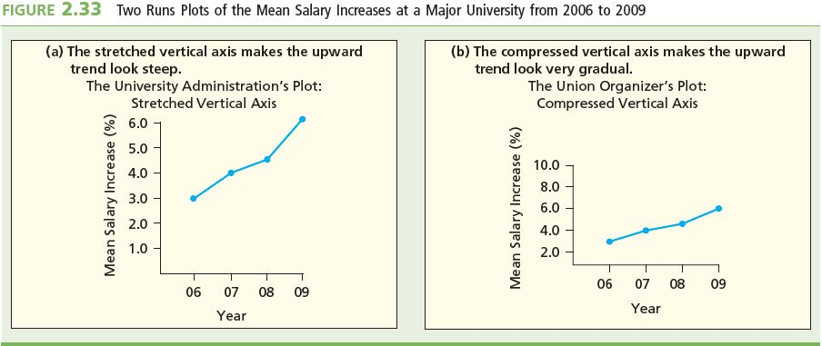
Misleading Graphs and Charts: Horizontal Scale Effects
Compress vs. stretch the horizontal scales to exaggerate or minimize the effect

Slide 67
Weighted Means
Sometimes, some measurements are more important than others
  Assign numerical “weights” to the data
    Weights measure relative importance of the value
Calculate weighted mean as
where w_{i} is the weight assigned to the i^{th} measurement of x_{i}

Slide 68
Example: Weighted Mean
2005 unemployment rates for various regions in Canada
Want the mean unemployment rate for Canada.
Census Region | Civilian Labour Force (Thousands) | Unemployment Rate
Atlantic | 1,235 | 11.2%
Quebec | 4,197 | 8.8%
Ontario | 7,182 | 9.2%
West | 5,774 | 6.1%

Slide 69
Example: Weighted Mean
Want the mean unemployment rate for Canada.
Calculate it as a weighted mean
  So that the bigger the region, the more heavily it counts in the mean
    The data values are the regional unemployment rates
    The weights are the sizes of the regional labor forces
  Note that the un-weigthed mean is 8.83%, which overestimates the true rate by 0.56%
    That is, 0.0056 × 18,387,800 thousand = 192,972 workers

Slide 70
Descriptive Statistics for
Grouped Data (Sample)
Data already categorized into a frequency distribution or a histogram is called grouped data
Sample mean for grouped data:
Sample variance for grouped data:
where f_{i} is the frequency for class i
M_{i} is the midpoint of class i
n = Sf_{i} = sample size

Slide 71
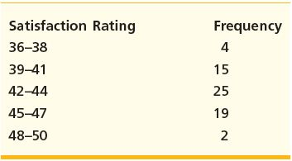
Example: Grouped Data
Given a frequency distribution of customer satisfaction ratings compute the grouped mean and the grouped variance

Slide 72
Grouped Mean

Slide 73
Grouped Variance

Slide 74
Descriptive Statistics for
Grouped Data (Population)
Population mean for grouped data:
Population variance for grouped data:
where f_{i} is the frequency for class i
M_{i} is the midpoint of class i
N = Σf_{i} = population size

Slide 75
Geometric Mean
For percent rates of return of an investment, use the geometric mean to give the correct terminal wealth at the end of the investment period
Suppose the rates of return (expressed as decimal fractions) are R₁, R₂, …, R_{n} for periods 1, 2, …, n
The mean of all these returns is the calculated as the geometric mean:

